Slide 1
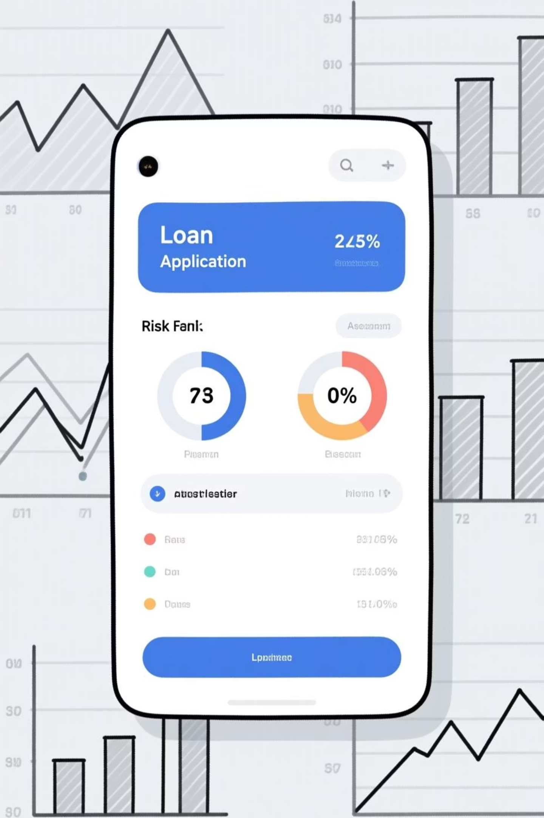
Loan Application Data Analysis
This project analyzed loan applications to identify factors influencing default risks among urban customers. The goal was to minimize financial losses while maintaining business growth by approving eligible applicants. A clean and accurate dataset was pivotal for sound decisions.

Slide 2

Tech Stack & Key Tasks
MS Excel
MS Word
ChatGPT
Data cleaning, graphs, tables, dashboards.
Documentation of tasks and results.
Summarizing insights for stakeholders.
Our primary tasks included identifying and handling missing data, detecting outliers, analyzing data imbalance, and performing various statistical analyses.

Slide 3


Handling Missing Data
We analyzed application.csv for missing values. Columns with over 62% missing data were removed (91 columns deleted). Important columns like NAME_TYPE_SUITE and OCCUPATION_TYPE were filled using Mode ("Unaccompanied") and "Unknown" respectively.
After cleaning, 31 columns remained from the original 122. This preserved core information for risk modeling without major feature loss.

Slide 4
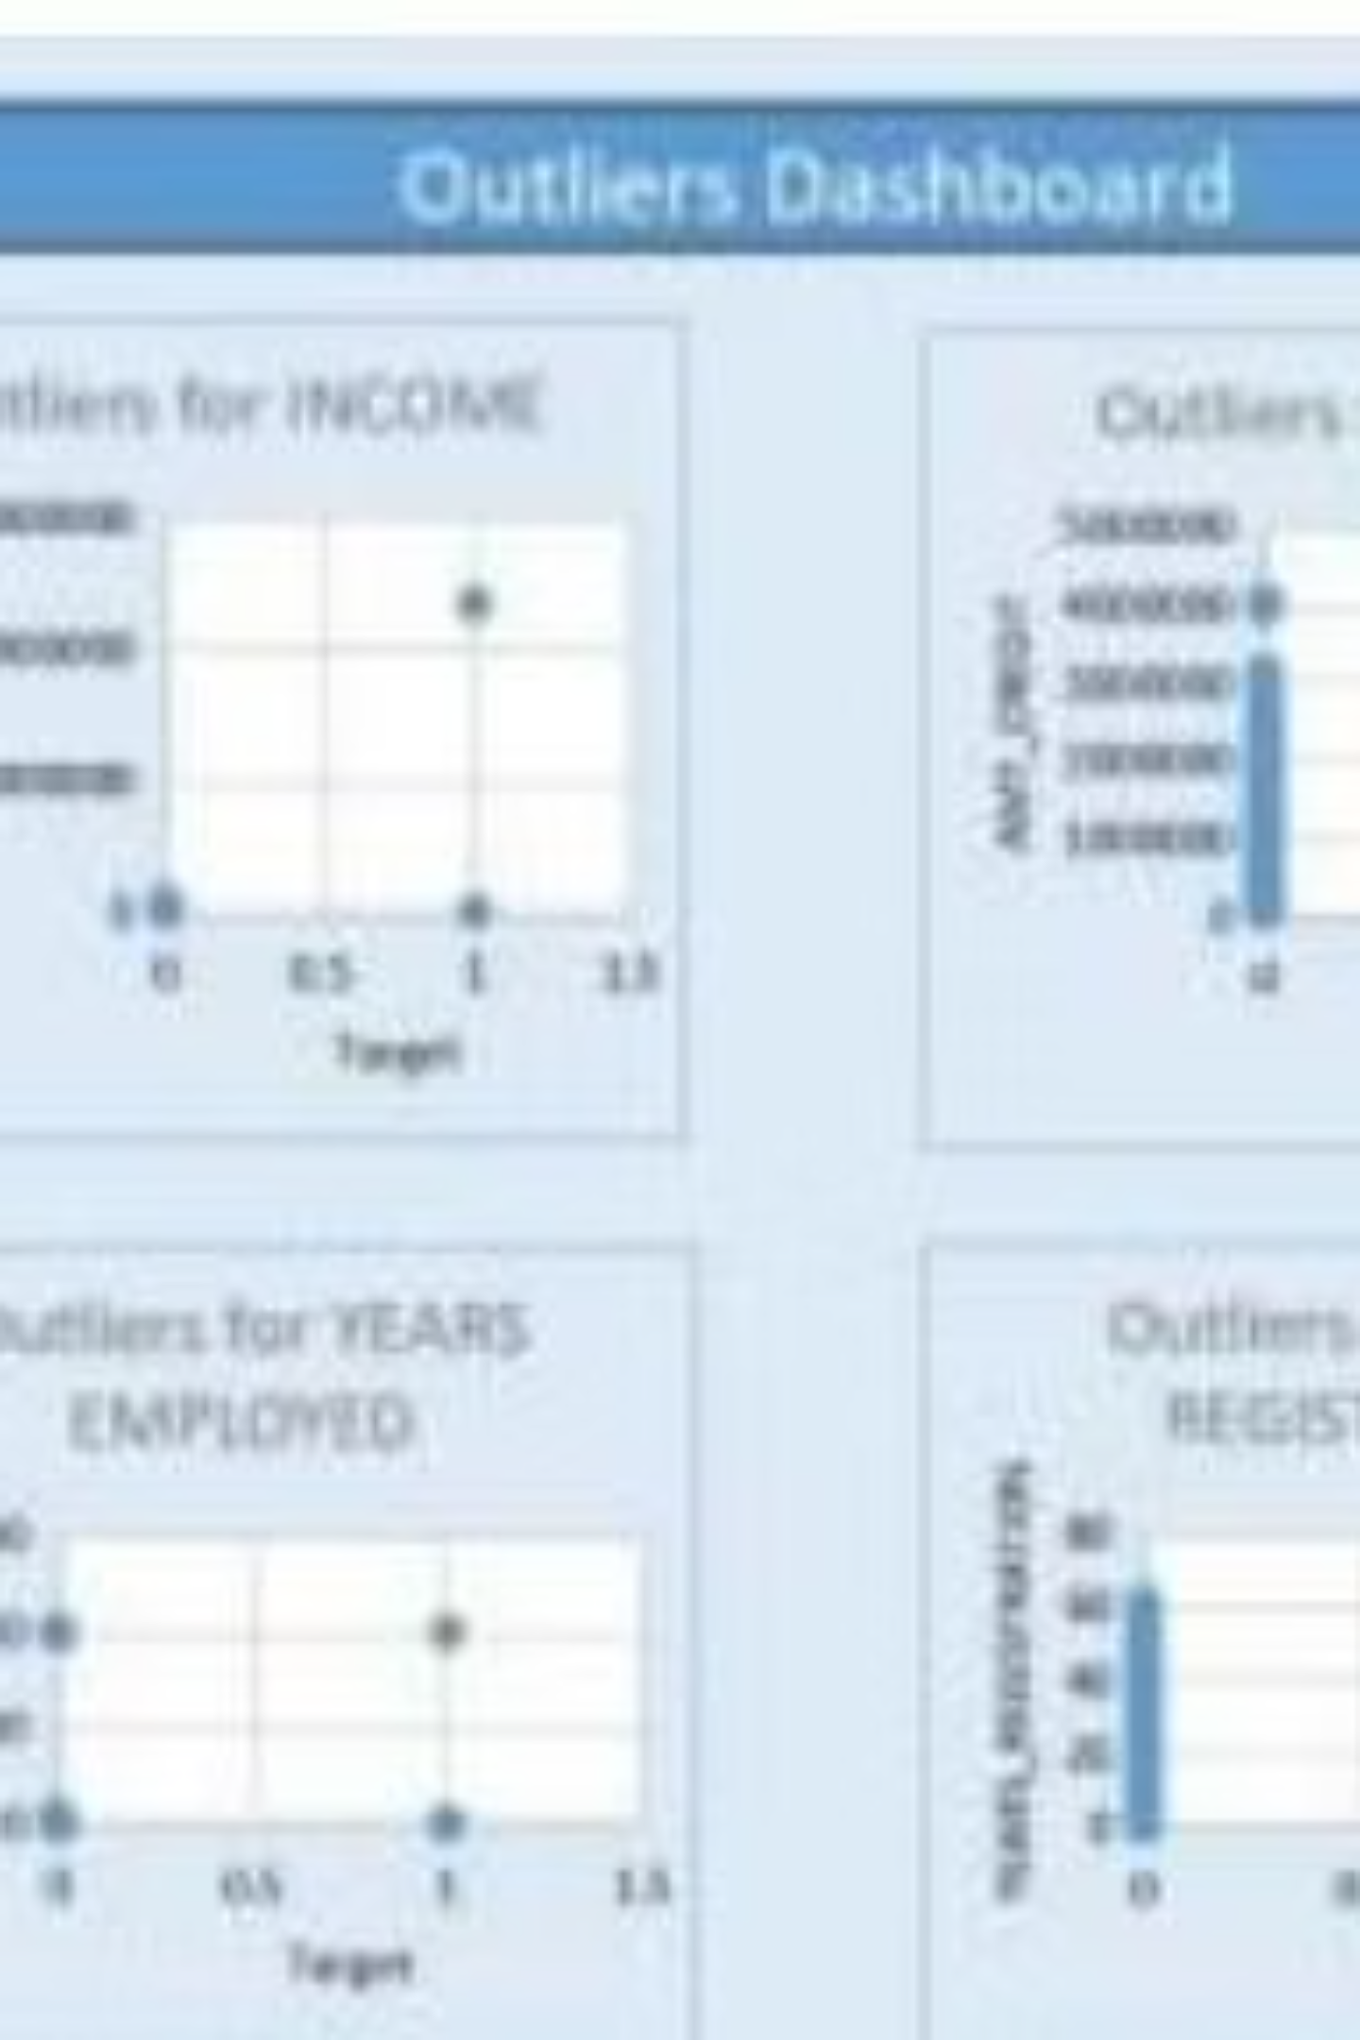
Identifying Outliers
Outliers were detected and handled to ensure reliable analysis. Scatter plots were created for numerical attributes against the target column. Key attributes like CNT CHILDREN, AMT INCOME TOTAL, and YEARS EMPLOYED showed noticeable outliers.
CNT CHILDREN
AMT INCOME
Outliers with 9 and 11 children, rare but possible large families.
An exceptionally high income outlier, possibly a high-net-worth individual.
YEARS EMPLOYED
Extreme outliers of 1001 years, indicating data entry errors.

Slide 5
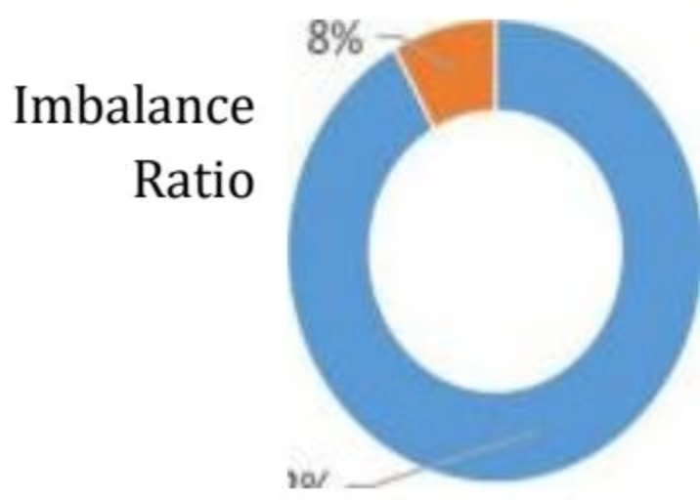
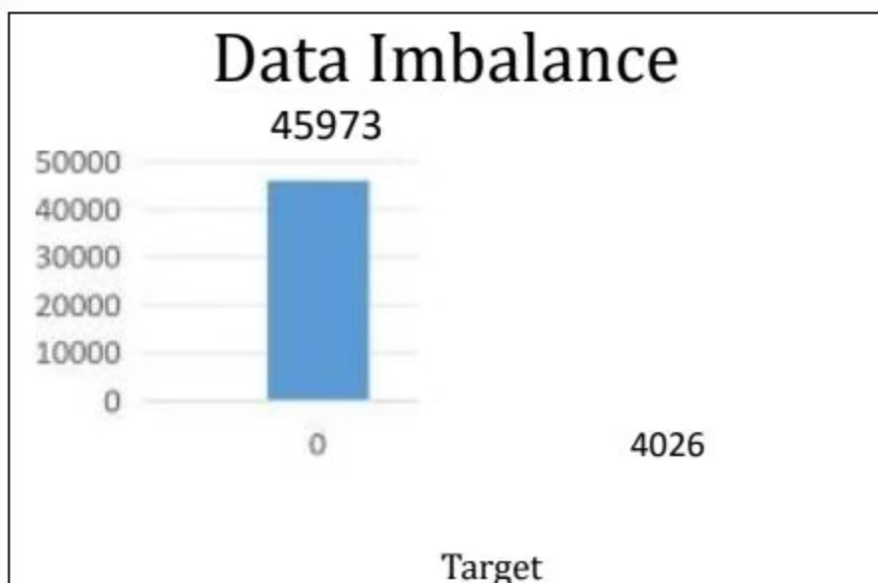
Analyzing Data Imbalance
We analyzed the imbalance in loan approval cases (default vs. non-default). A pivot table and charts showed a significant skew.
Non-defaulters (Target = 0) comprise 92% (45,973 entries), while defaulters (Target = 1) are 8% (4,026 entries). This imbalance could lead to biased model predictions.

Slide 6
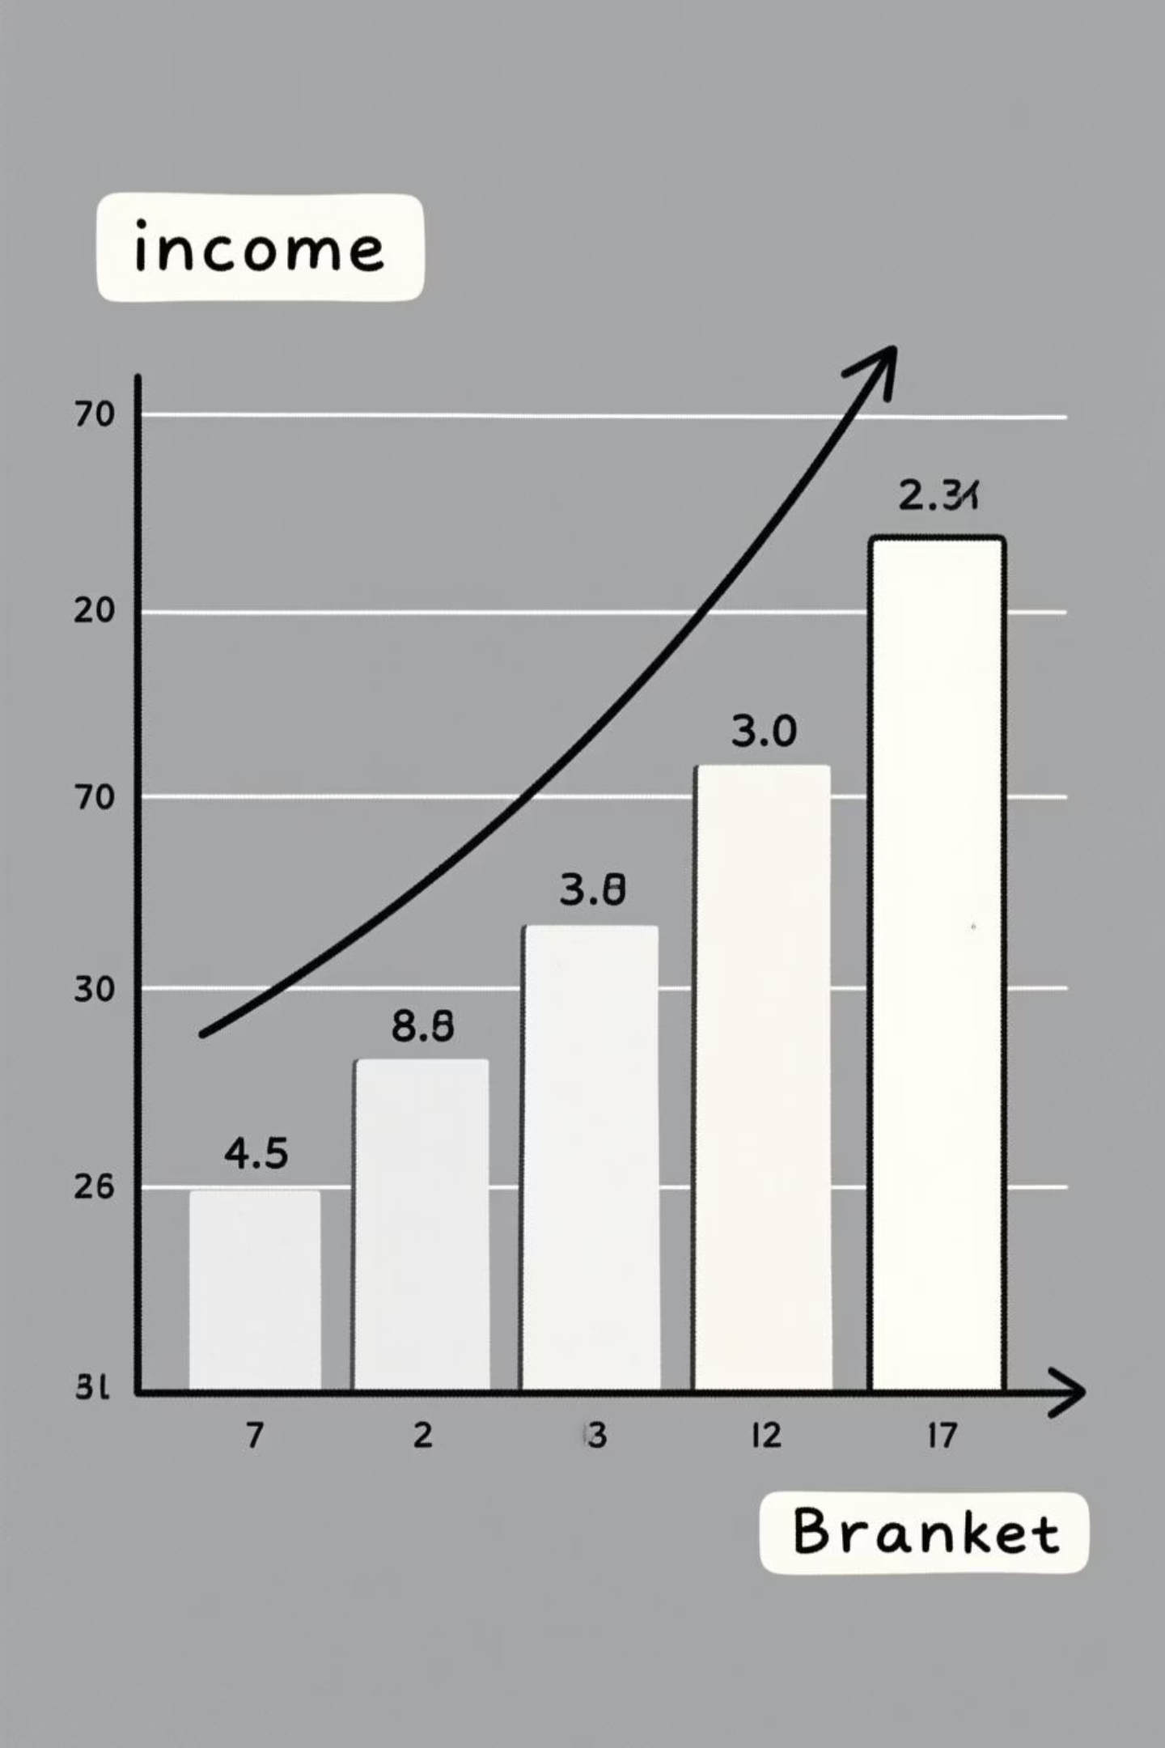
Income Analysis: Univariate & Segmented
We performed univariate and segmented univariate analysis on income to understand customer behavior and risk patterns.
Univariate Insight
Majority of applicants (24,040) are in the lowest income group (₹2,56,630). Higher income groups have significantly fewer applicants.
Segmented Insight
Defaulters are concentrated in lower income groups (4,026 in ₹1 - ₹2,56,630 range), suggesting a strong correlation between lower income and higher default rates.

Slide 7
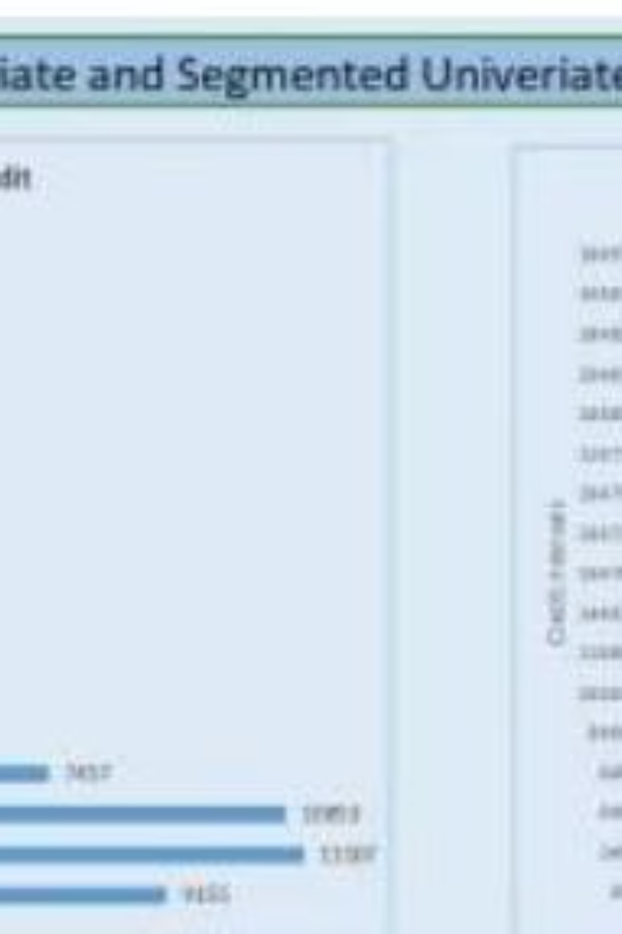
Credit Analysis: Univariate & Segmented
Analysis of credit distribution revealed insights into default risk across different credit groups.
Prioritize Risk Management
1
Defaulters are concentrated in lower credit brackets (₹45,000 - ₹16,47,000). Strengthen risk assessment for these applicants.
Tailored Lending Products
2
Higher credit groups show fewer defaulters. Offer premium loan products to attract these lower-risk applicants.

Slide 8
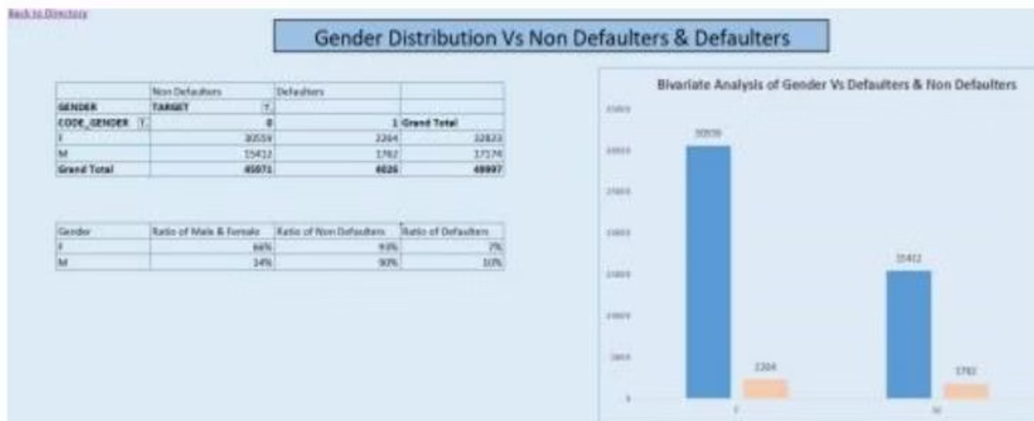
Gender & Default Risk
Bivariate analysis of gender against default status revealed distinct patterns.
Gender
Non Defaulters
Defaulters
Grand Total
F
30559
2304
32863
Female Applicants
M
13423
1762
15185
Higher proportion of non-defaulters, suggesting lower risk.
Grand Total
43982
4066
48048
Male Applicants
66% of applicants are female, with 93% being non-defaulters. Males, 34% of applicants, account for 10% of defaulters.
Higher default rate, indicating they are relatively riskier borrowers.

Slide 9
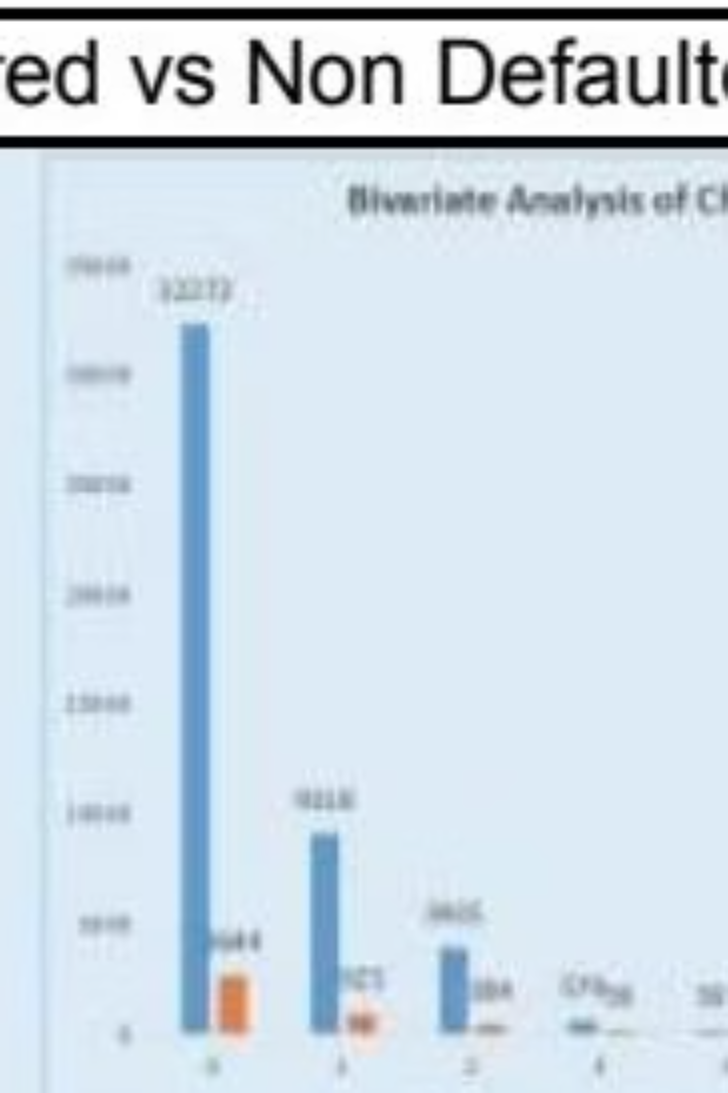
Children & Default Risk
Bivariate analysis of children count versus default status.
1
Fewer Children (0-3)
Higher default rate. Applicants with 0 children make up a significant portion of defaulters (2,644). Those with 1-3 children also show notable risk.
2
More Children (4+)
Lower default rate. Applicants with 4 or more children have much lower numbers of defaulters (17 out of 92 total for 4-6 children).

Slide 10

Top Correlations & Skills Gained
Key Correlations
Strong correlations were found between AMT_CREDIT, AMT_GOODS_PRICE, and AMT_ANNUITY for non-defaulters. For defaulters, income alone was not sufficient for prediction.
Data Cleaning & Pre-processing
Data Analysis Using Pivot Tables
Data Visualization & Problem-Solving
New Concepts: Outliers, Univariate, Bivariate, Data Imbalance
MS Excel Proficiency
Results
Successfully cleaned a noisy dataset, identified critical default factors (income, occupation, gender, age), addressed outliers, and developed visual dashboards for insights. These insights will enhance credit risk management.

